Slide 2
Introduction to
SIG Cluster Lifecycle
Justin Santa Barbara and Lubomir I. Ivanov

Slide 3

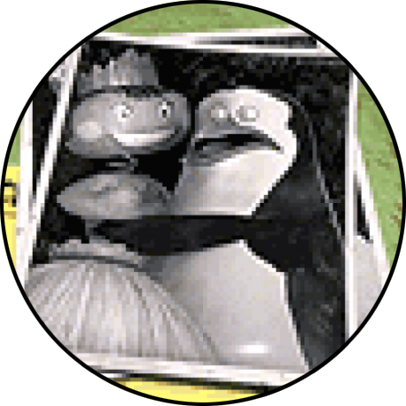
About
Justin Santa Barbara
SIG Cluster Lifecycle co-lead
Software Engineer @ Google
justinsb @ GitHub
Lubomir I. Ivanov
SIG Cluster Lifecycle co-lead
Software Engineer @ VMware OSPO
neolit123 @ GitHub

Slide 4
Agenda
What is SIG Cluster Lifecycle?
The mission and philosophy of the SIG
The stack of subprojects
Project Highlights
Kubeadm
Cluster API
Component Config
Get Involved
How to contribute
Survey

Slide 5
What is SIG Cluster Lifecycle?

Slide 6

Mission
“SIG Cluster Lifecycle’s objective is to simplify creation, configuration, upgrade, downgrade, and teardown of Kubernetes clusters and their components.” Taken from the SIG charter document

Slide 7
Vision
Develop the tooling necessary to build a highly automated meta cloud:
Avoid the pitfalls of the past
Declarative API-driven k8s deployments
Managing clusters should be as easy as managing k8s Pods
Make the 80% use case simple and the 20% use case possible
Commoditize k8s cluster deployments

Slide 8
The Stack
k8s cluster provisioners
Cluster API
cluster-addons
image builder
ComponentConfig
kubeadm
etcdadm

Slide 9

Unix Philosophy
Make each program do one thing well
Make the boundary lines explicit
Set non-goals
~Every computing infrastructure project that initially meets one need well will eventually expand in scope to only meet several needs poorly.
Expect the output of every program to become the input to another program.
Using them together to form a Voltron-like software

Slide 10
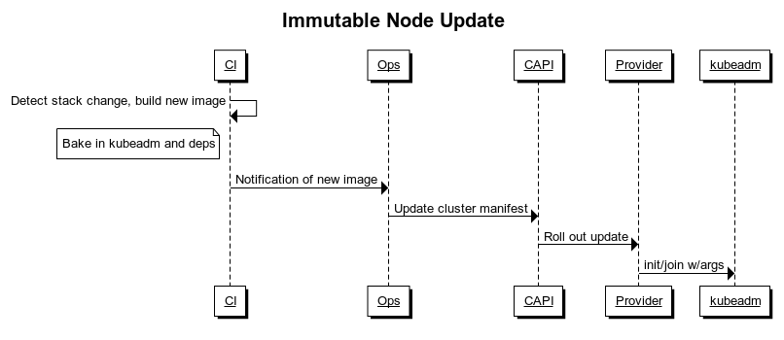
Pseudo Voltron Example

Slide 11
Project Highlights

Slide 12

Kubeadm
A Kubernetes cluster bootstrapper
kubeadm’s task is to set up a best-practice cluster for each k8s version
The user experience should be simple, and the cluster reasonably secure
kubeadm’s scope is limited; intended to be a building block
Only ever deals with the local filesystem and the Kubernetes API
Setting up or favoring a specific CNI network is out of scope
Composable architecture with everything divided into phases
Allows for DIY using other higher level tools as chef/puppet/etc.

Slide 13
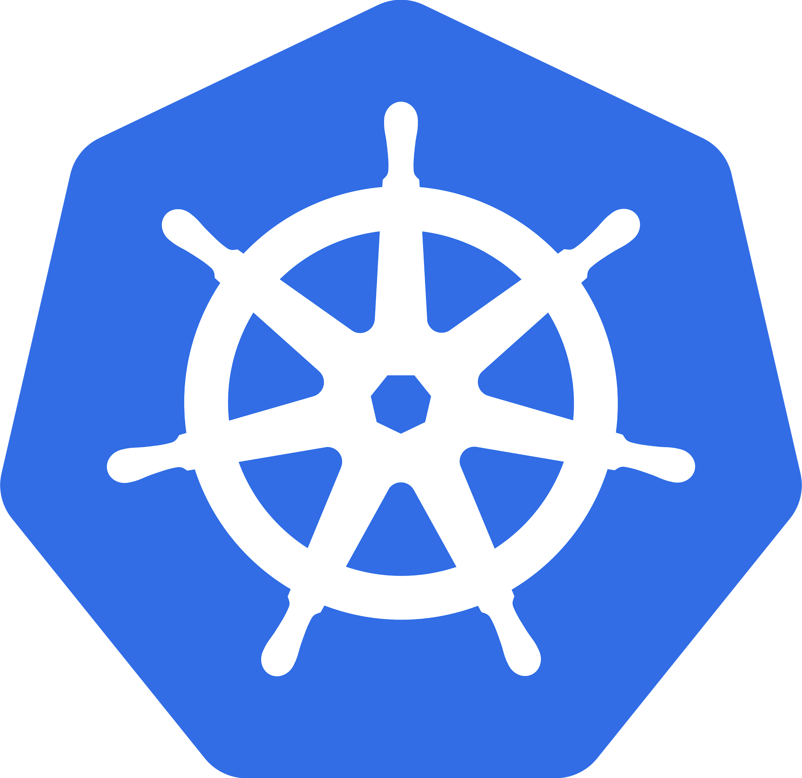





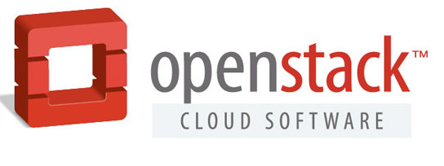

Kubeadm: Usage
Example usage of kubeadm
Cluster API
Cluster API Spec
Cluster API Implementation
Layer 3
Infra Orchestration
Addons
CSI / Cloud Provider
Load Balancers
Monitoring
Logging
Kubernetes API
Layer 2
kubeadm
Bootstrapping
kubeadm
kubeadm
kubeadm
kubeadm
Machines
Control-Plane 1
Control-Plane N
Node 1
Node N
Layer 1
Infra Provider
Infrastructure

Slide 14
Kubeadm: Roadmap
Simplify day 2 operations (Create a kubeadm-operator):
Allow for re-configuration using a declarative pattern
Support new workflows: change the cluster, certificate rotation etc.
Make kubeadm more friendly for higher-level tools
Make phases retryable and idempotent (where possible)
Machine readable output
Increase flexibility around addons and etcd (cluster-addons and etcdadm integration)
Consider moving core addons (CoreDNS, kube-proxy) to operators
Lower the barrier between local etcd and external etcd
Simplify component config management
Move kubeadm out of tree
Define the release process and build the automation
Allow easier vendoring

Slide 15

Kubeadm: Learn More
Kubeadm Deep Dive
Rostislav Georgiev, VMware & Rafael Lopez, SUSE
KubeCon EU 2020, Wednesday, August 19, 13:00 CEST
https://sched.co/Zev8

Slide 16
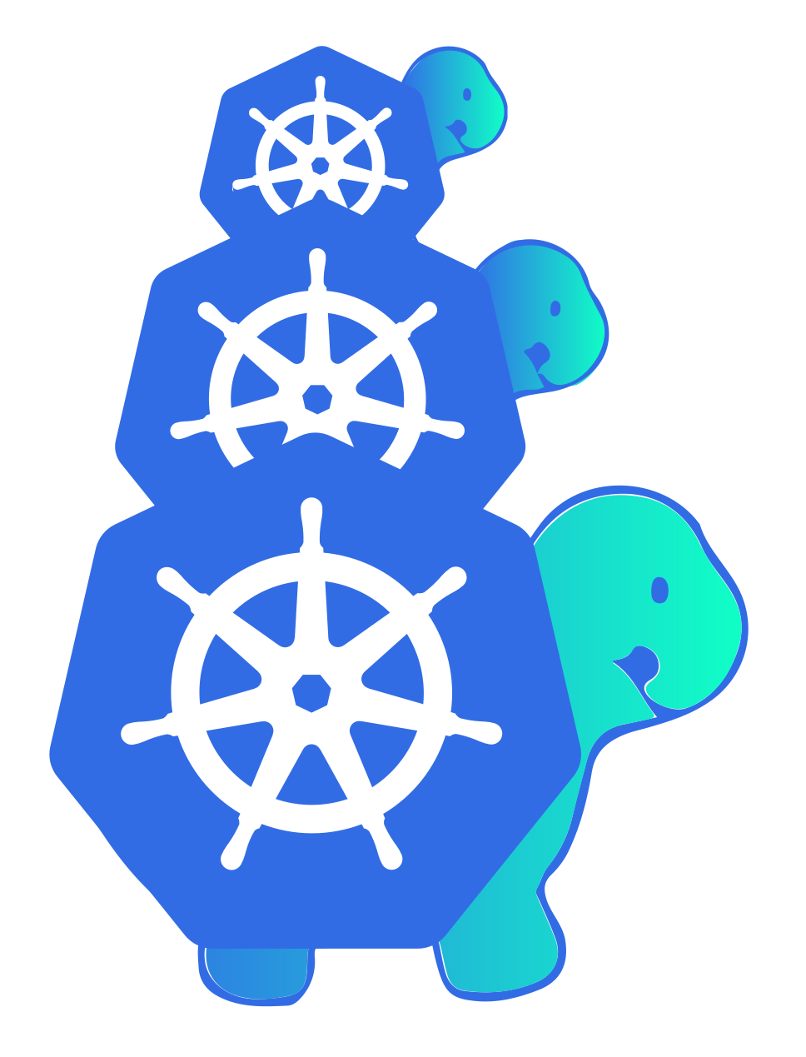
Cluster API
It is:
A declarative, Kubernetes-style API for cluster creation, configuration, and management across providers
Manages the lifecycle of other associated cluster infrastructure
An immutable (Node) deployment model
It is not:
A cloud provider abstraction layer
A tool that provides Node in-place upgrades

Slide 17
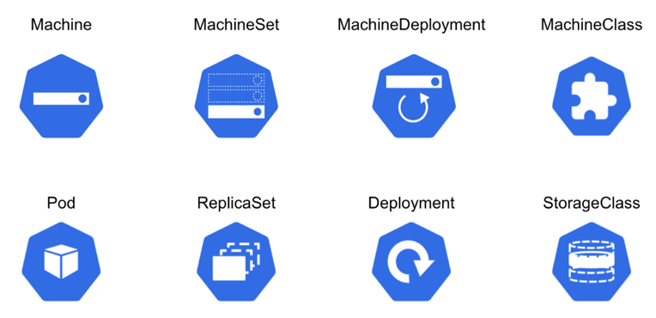
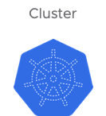
Cluster API: Design
Cluster API follows a familiar pattern
https://cluster-api.sigs.k8s.io/user/concepts.html

Slide 18
Cluster API: Roadmap
Optimize the UX where possible.
Get more feedback from the wild; see how users deviate from the defaults.
Automate all the things (build, deploy, test, release).
v1alpha3: better test plan, kubeadm control plane robustness, spot instance support, autoscaler, clusterctl extensible templating, etc.
v1alpha4: machine bootstrap failure detection, pluggable machine load balancers, support the latest kubeadm API, etc.
Towards Beta:
Better documentation.
Submit the project for API review.
Adoption goals:
Integration in Kops.
Make the existing Kubernetes e2e tests use Cluster API on GCP/AWS.
https://cluster-api.sigs.k8s.io/roadmap.html

Slide 19

Cluster API: Learn More
Cluster API Deep Dive
Naadir Jeewa, VMware & Cecile Robert-Michon, Microsoft
KubeCon EU 2020, Wednesday, August 19, 16:55 CEST
https://sched.co/Zevc

Slide 20
Component Config
ComponentConfig is a Kubernetes style API for configuring components
Problem 1: The core Kubernetes components are not consistent in how they are configured (they use a lot of flags).
Solution: Core components have started working on their ComponentConfig (kube-apiserver not yet)
Problem 2: It is pretty hard to write a k8s-like component with declarative config
Solution: Factor common component-related code into a `k8s.io/component-base` toolkit repository. Make it easier to write a non-core component that follows the k8s API style for its configuration. Existing components should be retrofitted to use the toolkit.

Slide 21
Component Config
Maintainability: When $component’s flag set grows over 50+ flags, configuring it becomes painful
Upgradability: For upgrades, versioned configuration is easier to manage than flags, since flags are unversioned
Programmability: Configuration expressed as JSON/YAML objects allows for consistent manipulation - templating, patching, introspection
Possibility: Many types of config simply cannot be expressed as key-value pairs
Declarative: OpenAPI information can easily be exposed / used for doc generation
See Lucas Käldström’s talk on this here: Configuring Your Kubernetes Cluster on the Next Level

Slide 22

WG Component Standard
There is a Kubernetes Working Group called “Component Standard” that is tackling these problems.
Find more about it here:
https://bit.ly/2OT5Vqo
https://github.com/kubernetes/community/tree/master/wg-component-standard

Slide 23
Get Involved

Slide 24
Help Wanted
We need your help! There is still a lot of work to do in order to build voltron!
k8s cluster Provisioners
Cluster API
cluster-addons
ComponentConfig
image-builder
kubeadm
etcdadm
GA
Beta
Alpha
Pre-Alpha

Slide 25
How you can contribute
SIG Cluster Lifecycle New Contributor Onboarding
Navigate to our community page
Look for “good first issue”, “help wanted” labeled issues in our repositories
Help with docs and testing
Attend our Zoom meetings, and ask questions
Introduce yourself on Slack
Attend/Watch new contributor sessions (SIG ContribEx)
Chop wood, carry water, be kind
Everyone `earns` their place at the table (social capital)

Slide 26
Related Talks
Other related talks at KubeCon EU 2020
Minikube
Rohit Anand, NEC Corporation & Medya Ghazizadeh, Google
Wednesday, August 19 • 13:00 - 13:35 CEST
https://sched.co/Zexq
Dynamic Configuration with ComponentConfig and the Control Loop
Chris Hein, Apple & Leigh Capili, Weaveworks
Thursday, August 20 • 17:20 - 17:55 CEST
https://sched.co/ZemW

Slide 27

SIG Survey for 2020
Please fill this ~10 minute survey to help sig-cluster-lifecycle better understand our users!
https://bit.ly/2BrnGKp

Slide 28
Thank you! Q/A

